Slide 1
PRESENTATION
Project on
Spare Room
Submitted by
Milan Malla (017-350)
Shuveccha Silwal (017-381)
Sijan Joshi (017-382)

Slide 2
Introduction
Android app based on material design.
01
Location
02
Platform for ad
03
Based on ad hunt
Search for rooms based on specified location.
Platform for users both post ad for room and search for room
Relies on a user posting add and another user searching for posted ads and selecting the room suitable for the user.
04
Easy Searching
05
Save Money
06
Material Design
Eliminate hazardous process of visiting house to house in search for room
Save some money by sharing of the room with multiple room partners.
App based on material design.

Slide 3
Problem
Statement
Budget Problem
compelled to live in unfacilitated room due to low budget.
Spare Room
Compelled to pay rent of the room that is not used.
Busy Lifestyle
People are busy most of the time and they do not have time.

Slide 4

Ads
Search
platform to post ad for their spare room.
help user search for suitable room.
Our
Objective
Sharing
Easy
help other people by sharing their spare room.
get spare and vacant room without going house to house.

Slide 5
Scope and Application
Search Room
Post Room
Easiness
To facilitate user to search for spare and vacant room
post ad for spare and vacant room
Will eliminate a hazardous process of traditional room finding.

Slide 6
THE ABOUT
TECHNICAL FEASIBILITY
Technical Feasibility means whether the project is working in a perfect manner.
Feasibility
Study
OPERATIONAL FEASIBILITY
Operational Feasibility means the project must perform its operation perfectly.
ECONOMIC FEASIBILITY
Economic Feasibility is a term which is related to estimation of cost required for the project.
LEGAL FEASIBILITY
Legal Feasibility means the developing project must be legal

Slide 7
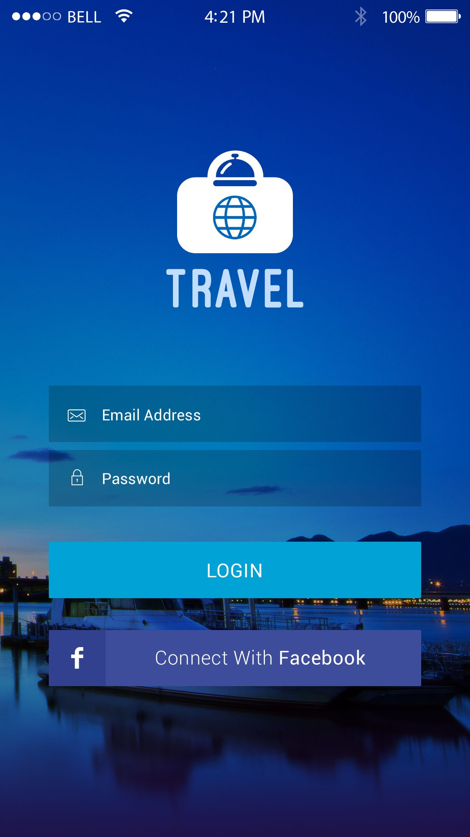

System Design
Our design is mostly based on material design. We have use guidelines provided by the material design team.
In future we will try to use Google's new material you design language.
SpareRoom

Slide 8



Software
Requirements
FLUTTER
FIREBASE
DART
Flutter is open-source UI software development kit created by Google.
Firebase is a mobile and web application development platform developed by Firebase, Inc.
Dart is a client-optimized programming language for apps on multiple platforms.

Slide 9
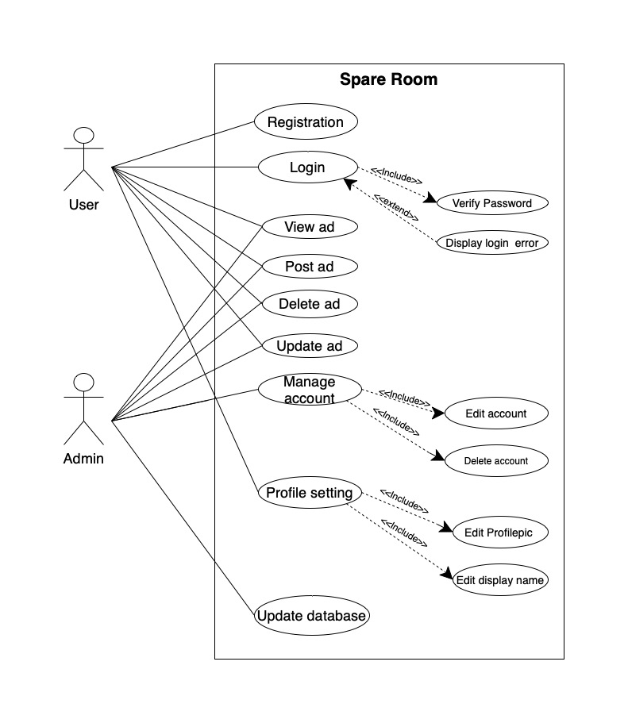
SpareRoom
Use Case
Diagram

Slide 10
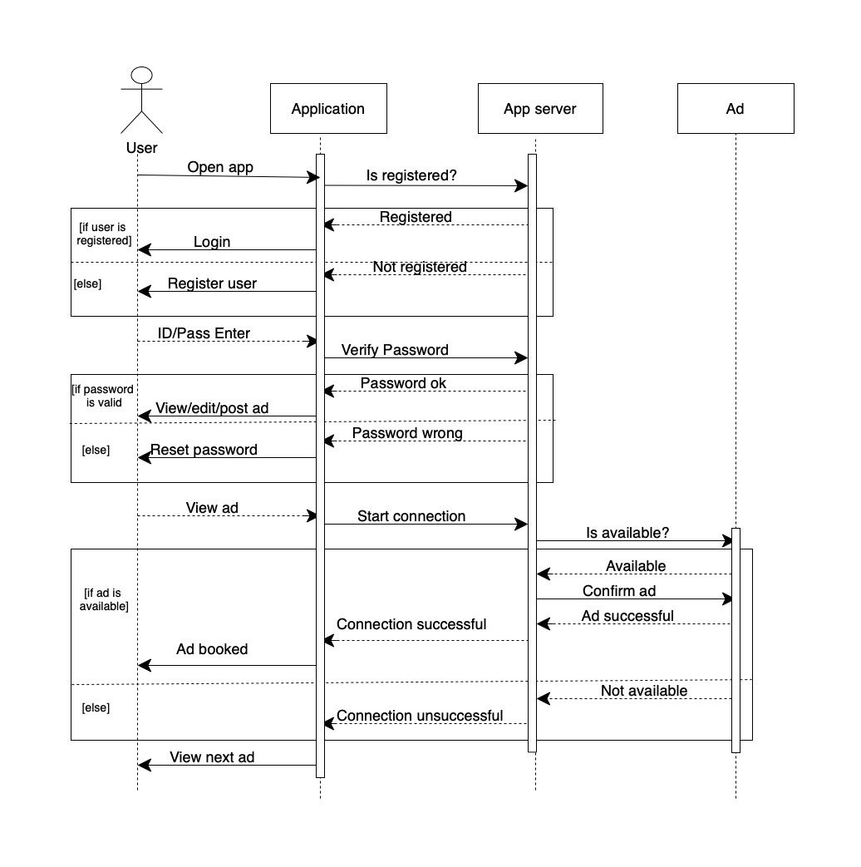
SpareRoom
Sequence
Diagram

Slide 11
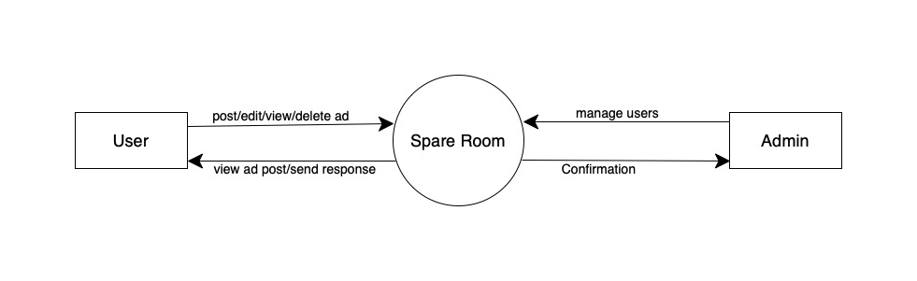
SpareRoom
Data Flow Diagram
0-level

Slide 12
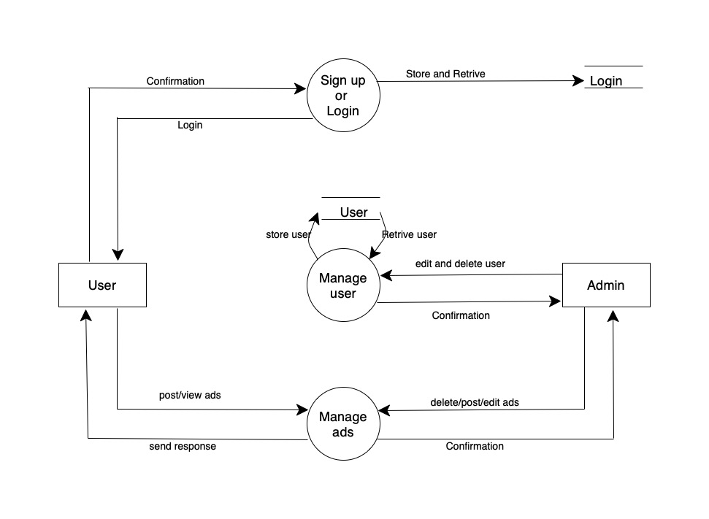
SpareRoom
Data Flow Diagram
1-level

Slide 13
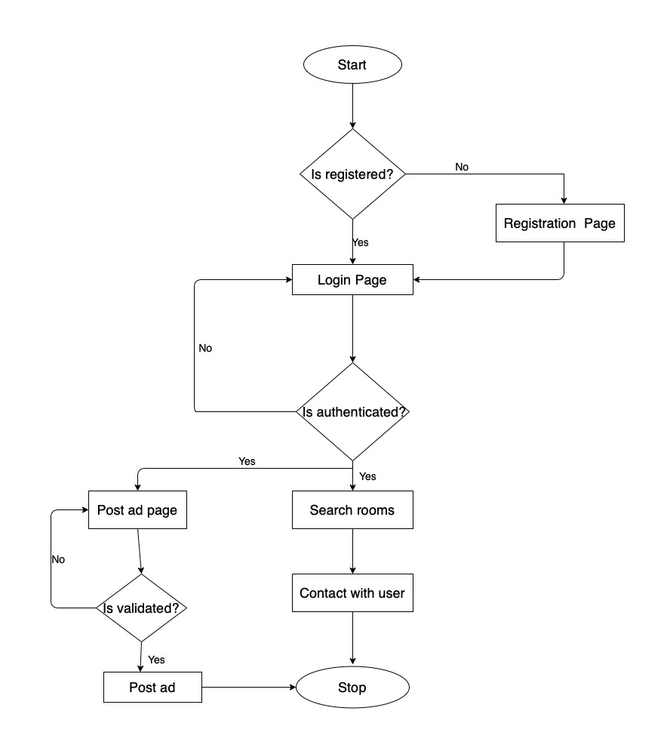
SpareRoom
Flow
Chart

Slide 14
Modules
01
02
03
04
Admin Module
User Module
Ad Module
Message Module
It is the module that has full control over other modules.
The module is responsible for the registration and management of the registered user.
This module manages the ad posted by the corresponding users
This module manages the messages between user about the room.

Slide 15



Implementation and Discussion
Technical Specifications
Firebase
Dart Language
Flutter
VS Code
Github
Google Map API
Firebase is a Google developed database that provides services like real-time database, storage, authentications, hosting etc.
Dart is an object-oriented programming language used to build anything on the web, servers, desktop and mobile applications.
Flutter is open-source UI software development kit created by Google
Visual Studio Code is a source-code editor that can be used with a variety of programming languages.
GitHub is a code hosting platform for version control and collaboration.
The Google Maps Platform is part of the Google Cloud Platform.

Slide 16
Successfully connect app with backend server(Firebase)
Completed design of application
Completed Authentication system,Registration System and User verification through email
Posting of vacant room ad with details and image is completed
Map feature for vacant room and ad location is added
User profile setting is completed
Messaging option between owner and tenant is completed
Work Completed
Following are total work completed in SpareRoom:

Slide 17
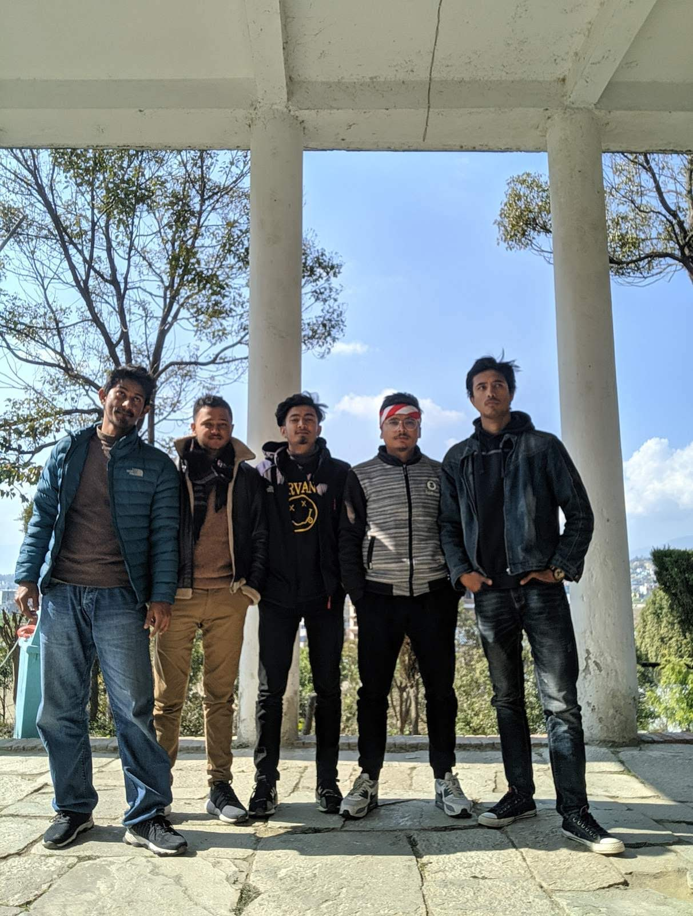
Future Work
Fake Image detection
Fake information report
Push notification and sms alert
Social Login/Signup
Automated communication service
Multi-lingustic support
Real time user feedback system
Features that can be implemented in
SpareRoom in future:

Slide 18
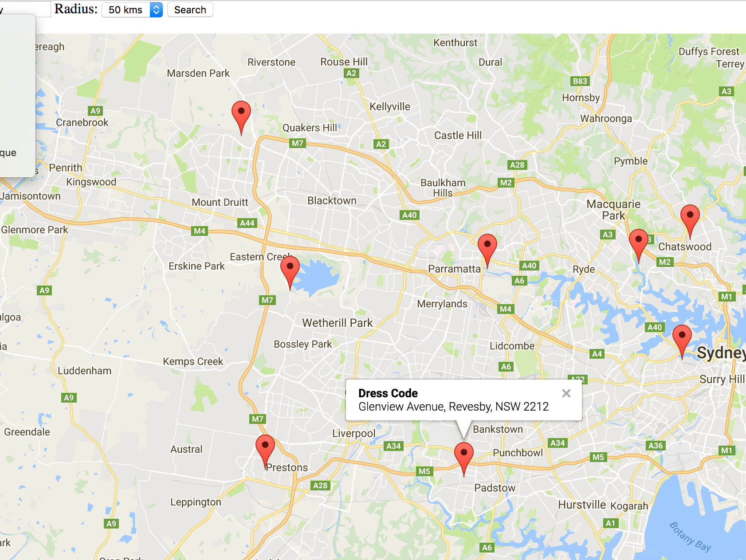
Conclusion
Easy user interface for searching vacant rooms
Owner can post ad with details,image with location
SpareRoom eliminates the traditional way of finding room
Users can use maps for searching vacant room and provide location
Messaging feature for communication users

Slide 19
Thank You
SpareRoom

